Slide 1
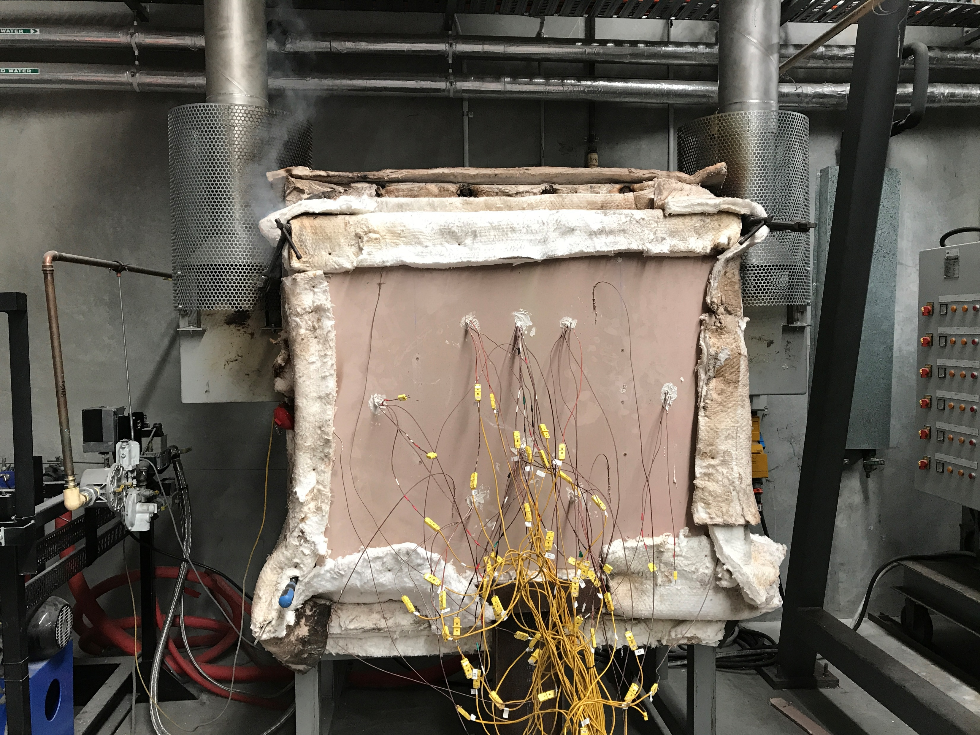
1 m
1 m

Slide 2
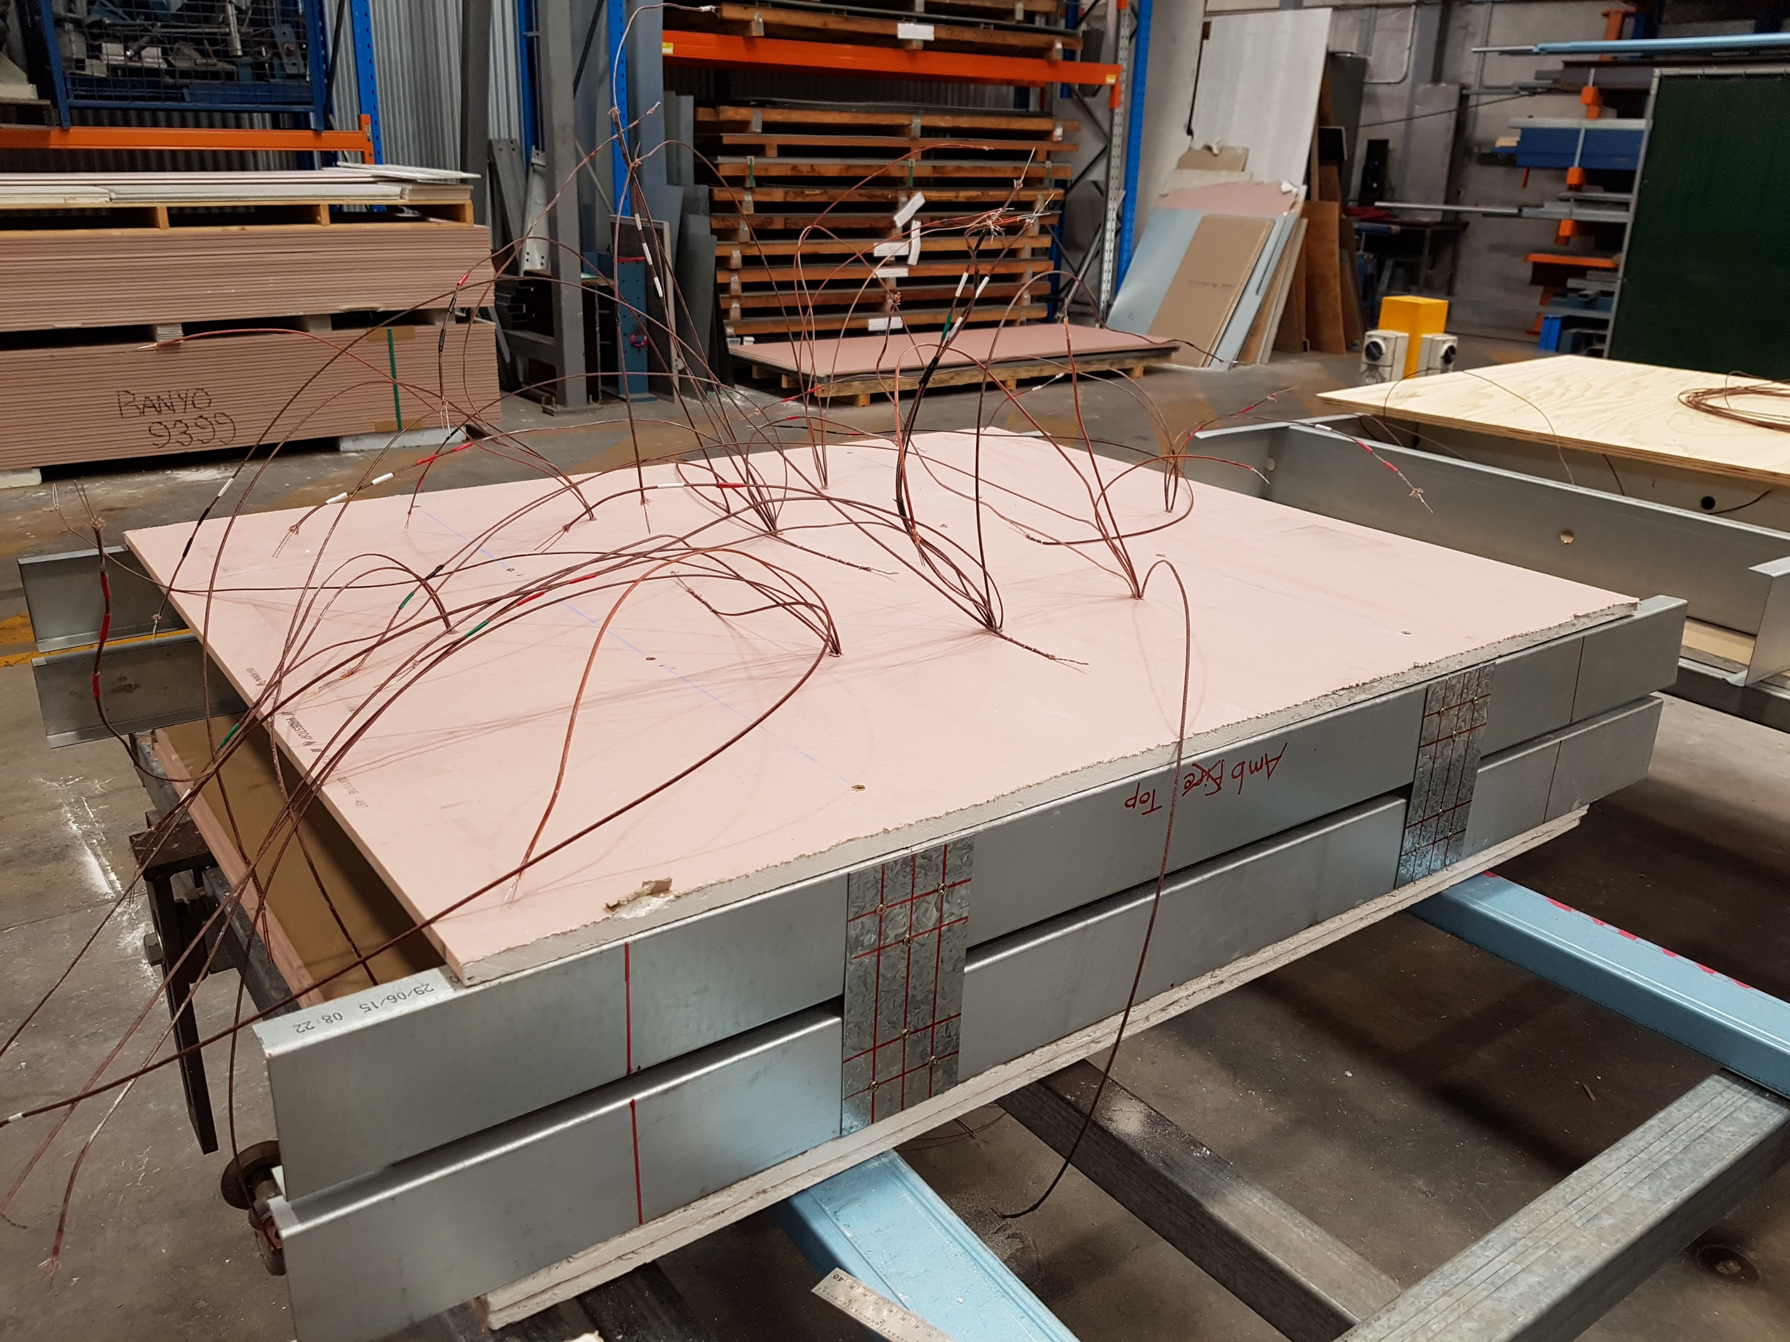
Thermocouples
Plasterboard
Tracks
Tracks
Spacer Plates at Stud Locations

Slide 3
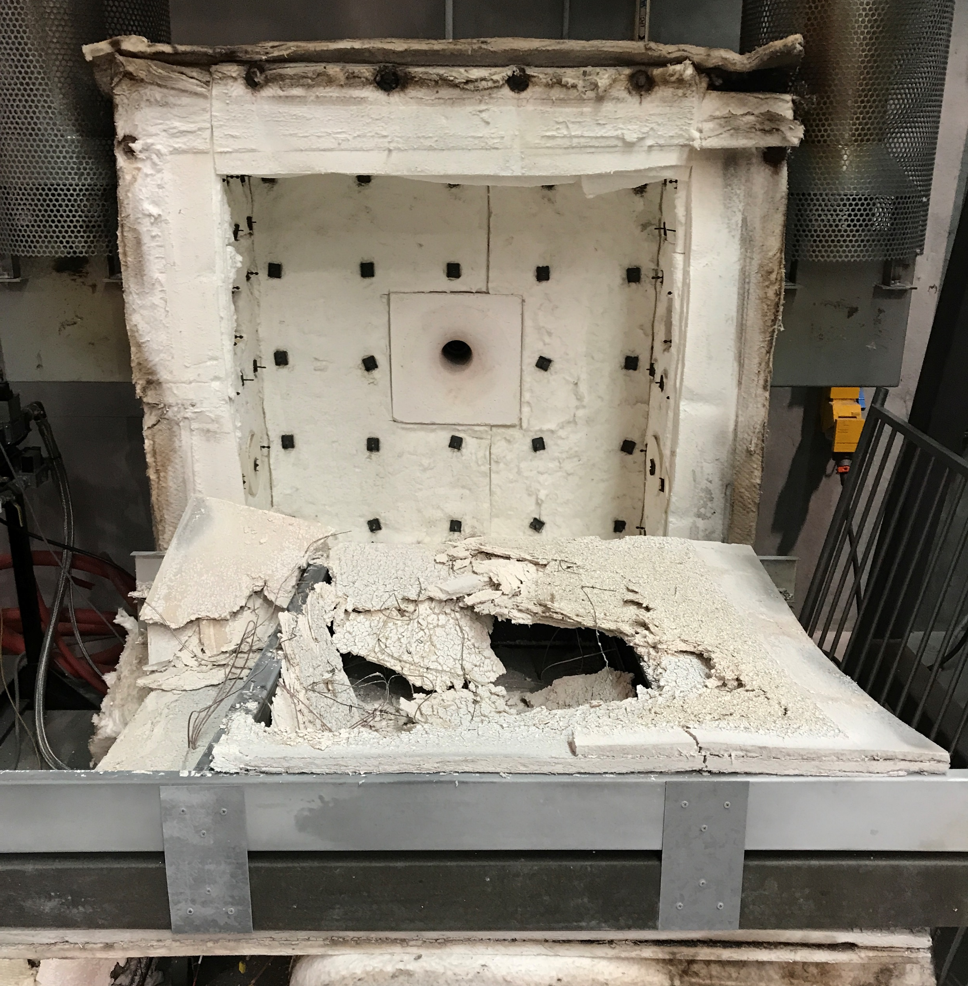
Fire Side
Plasterboard
Fall-Off
Furnace
Burner

Slide 4
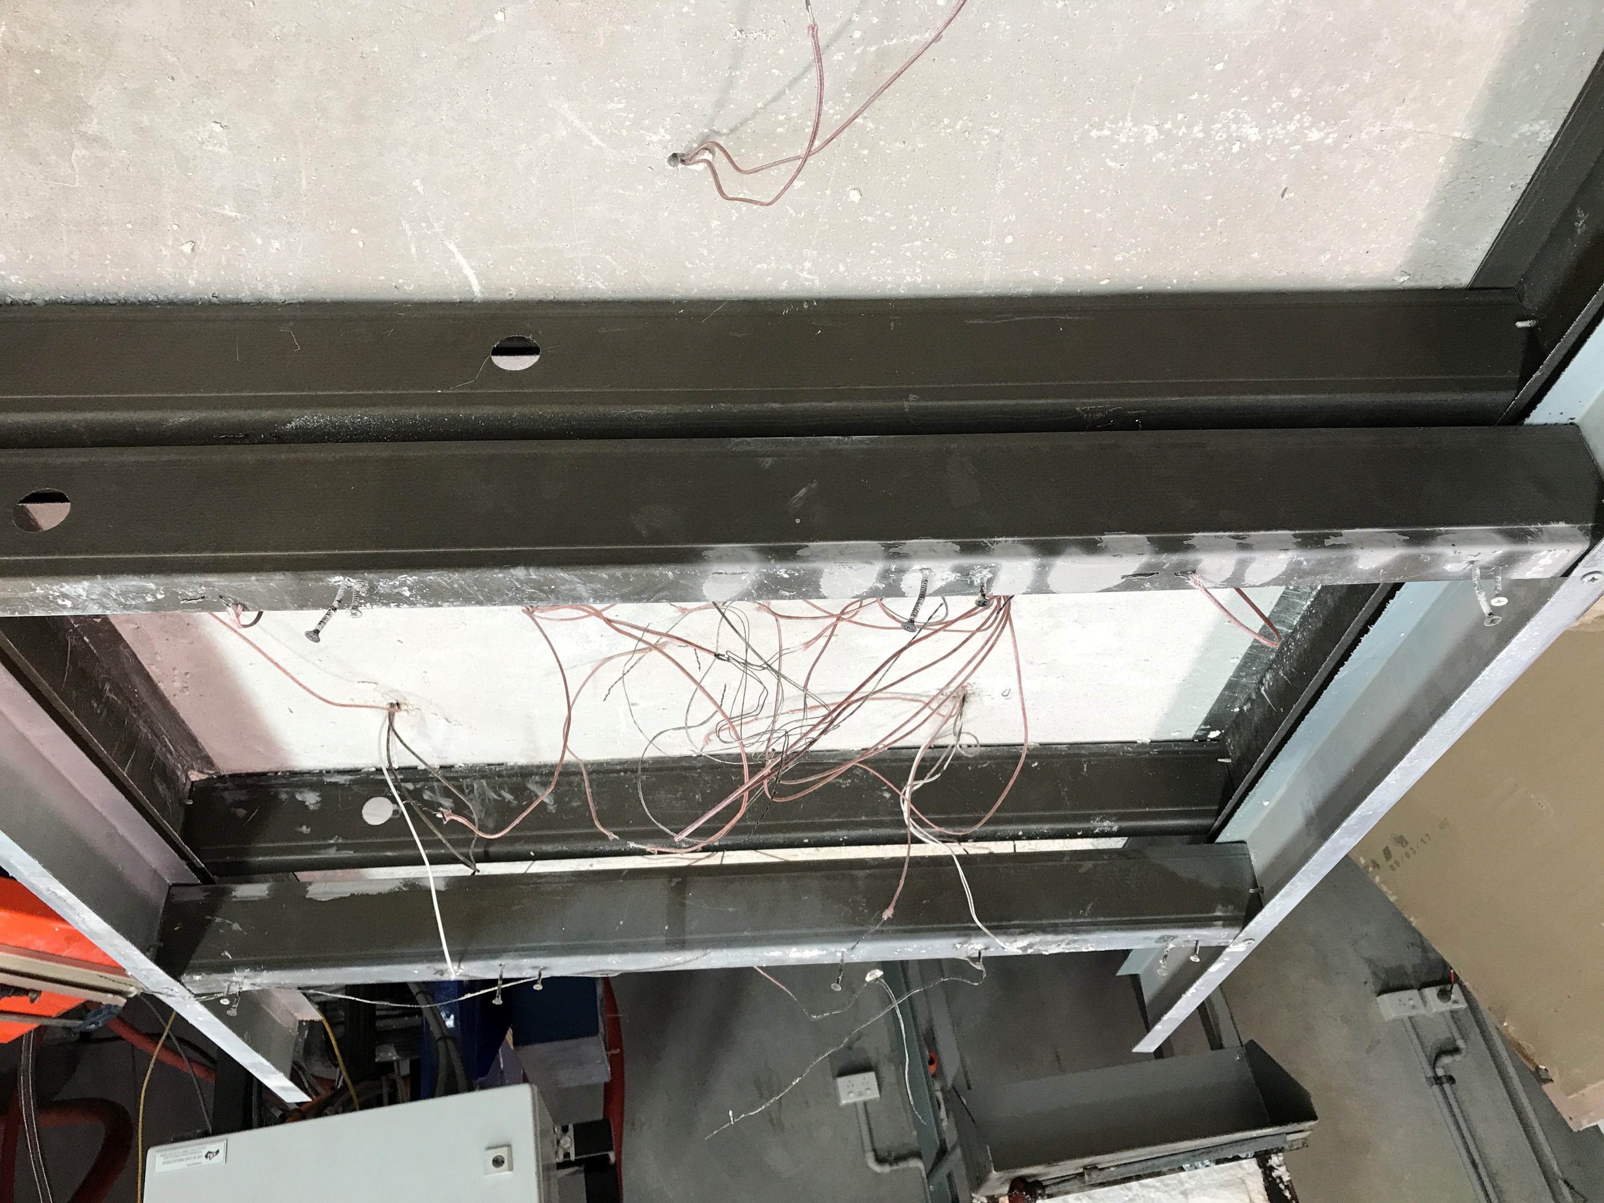
Studs After Fire Test
FHF
FCF
AHF
ACF

